Slide 1

Title: Science and scientific Thinking
Present By:
DR. Mohamed HAFEZ

Slide 2
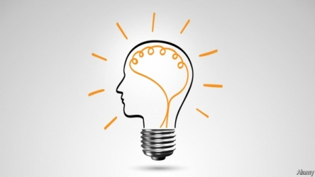

Scientific Thinking
The meaning of science
The Goals of Science
The characteristics of scientific knowledge
misinterpretations of scientific process

Slide 3
Scientific Thinking
What is science?
Science is not merely a collection of facts , concepts , and useful ideas about nature … But Science is a method of investigating nature..

Slide 4
Scientific Thinking
What is Reliable knowledge?
Reliable knowledge is Knowledge that has a high probability of being true

Slide 5

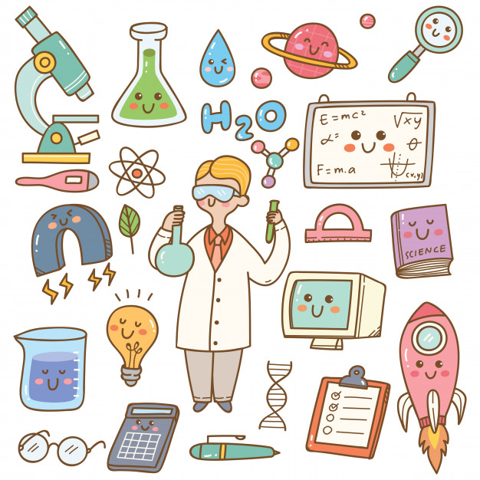
Scientific Thinking
The Goals of Science
Describe
Explain
Predict
control

Slide 6
Scientific Thinking
1- Describe
To understand the behaviors and events we study, we must describe or define them.

Slide 7
Scientific Thinking
2- Explain
To understand the behaviors and events we study, we must also identify the conditions within which they operate. In other words, we identify what causes a behavior or event to occur.

Slide 8

Scientific Thinking
3- Predict
Once we can describe and explain a particular behavior or event, we can use that knowledge to predict when it will occur in the future.
In other words, we can anticipate when the behavior or event will occur in the future.

Slide 9
Scientific Thinking
4- Control
The central, and often most essential goal for a scientist is control. Control means that we can make a behavior occur and not occur.

Slide 10


